Slide 1
Basic Concepts of HTML

Slide 2
HTML (Hypertext Markup Language) is a markup language used to create and structure content for the World Wide Web. It's the standard language used to create web pages and web applications, and it's a key technology that powers the internet.

Slide 3
HTML consists of a series of elements that define the structure and content of a web page. Each element is enclosed in angle brackets and typically consists of a start tag, content, and an end tag. For example, structure of an HTML document has .html extension.

Slide 4
HTML is made with HTML tags. HTML tags are used to define elements and provide structure to the content of a web page. Here are some commonly used HTML tags:
<head>: Contains metadata about the document.
<body>: Encloses the visible content of the web page, including text, images, links, headings, paragraphs, and other elements.

Slide 5
<p>: Defines a paragraph of text.
<a>: Creates a hyperlink or anchor element for linking to other web pages or resources.
<img>: Inserts an image into the web page.
<ul> and <ol>: Create unordered (bulleted) and ordered (numbered) lists

Slide 6
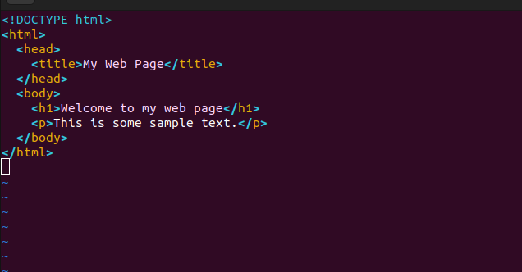
Basic Structure of HTML

Slide 7
In this example, the document begins with a <!DOCTYPE html> declaration that tells the browser what version of HTML to use. The <html> element encloses the entire document, and the <head> element contains metadata about the document. The <body> element contains the actual content of the page, which includes a heading (<h1>) and a paragraph (<p>).

Slide 8
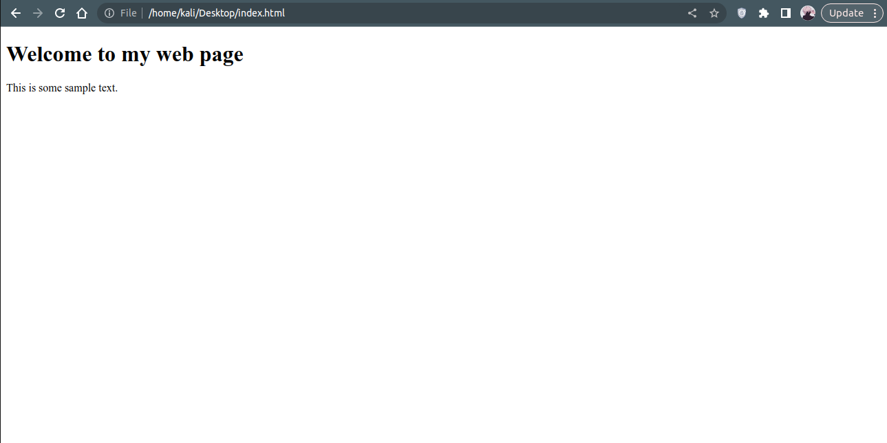
Result:

